Slide 1
Data Modelling Design Principles
Best Practices
Star Schema &
Snowflow Schema
Shrikesh Pattni

Slide 2
On next slides find me the “Fact Table(s)”

Slide 3
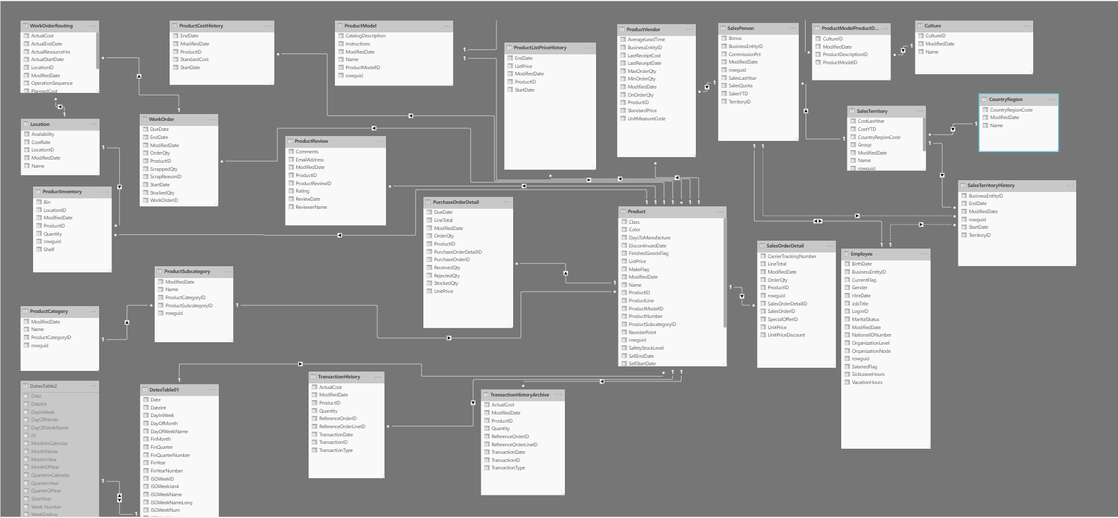
Shrikesh Pattni

Slide 4
How long did that take you?
Key Points:
Keep the model simple and layered
Keep relationships 1-To-Many

Slide 5
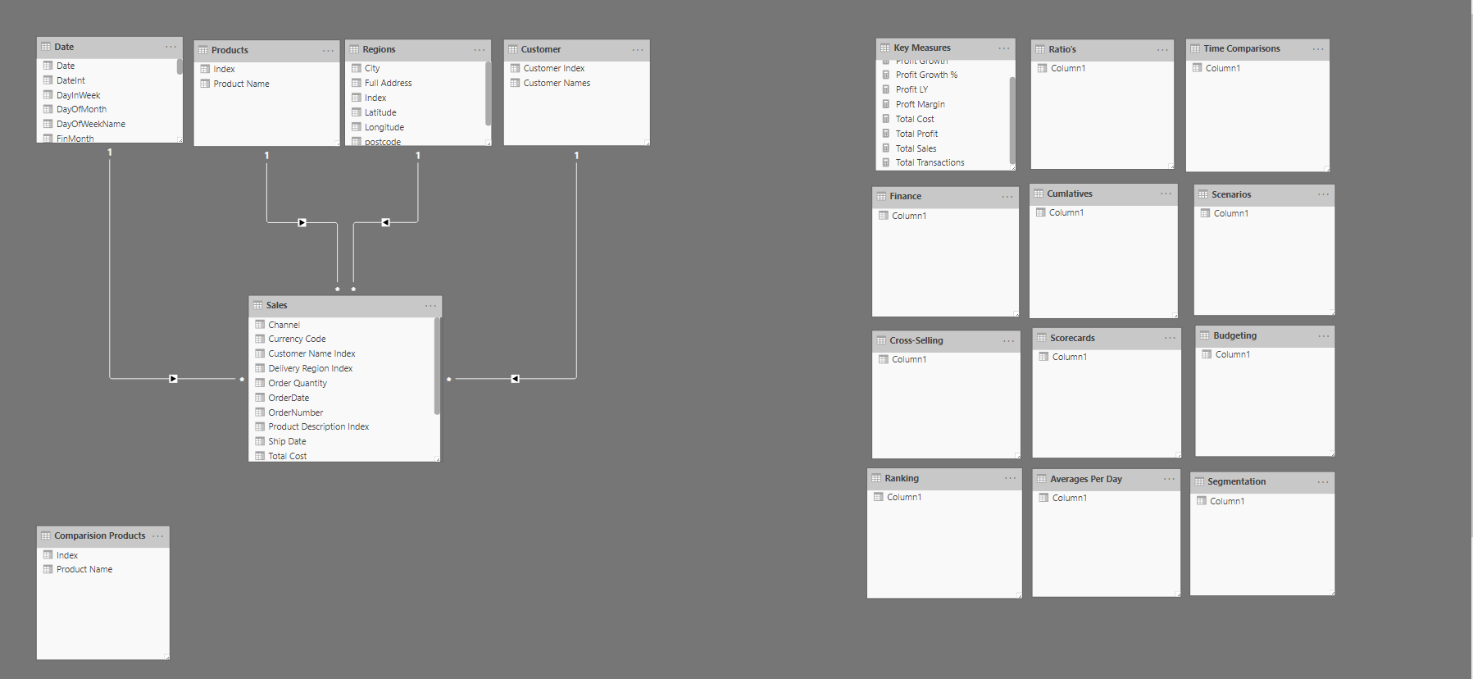
Star Schema - Model
Main dimension tables above.
(Use for filters, and DAX Calc)
LAYER 2
Shrikesh Pattni
Main Fact Tables
LAYER 1
Supporting Table Only.

Slide 6
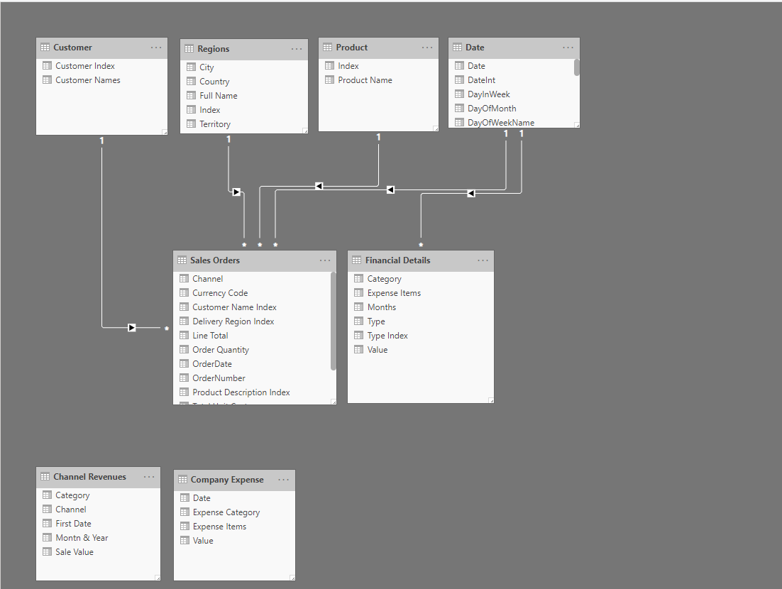
Star Schema - Model
Main dimension tables above.
(Use for filters, and DAX Calc)
LAYER 2
Shrikesh Pattni
Main Fact Tables. All my Sales/Budgeting/Forecasting related tables below
LAYER 1
These two tables have been unioned together to create my Financial Detail Table

Slide 7
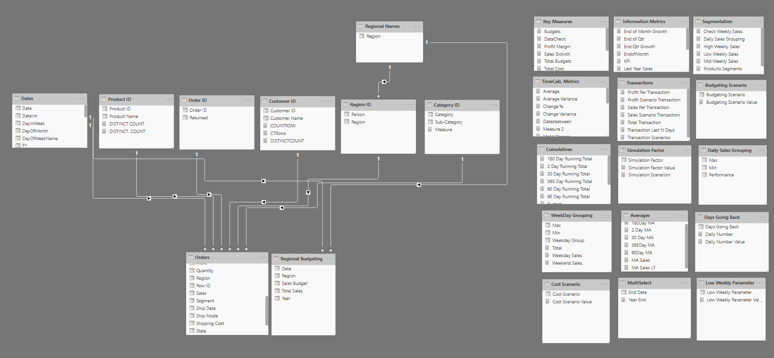
Snowflake Schema - Model
LAYER 3
LAYER 2
Shrikesh Pattni
LAYER 1

Slide 8
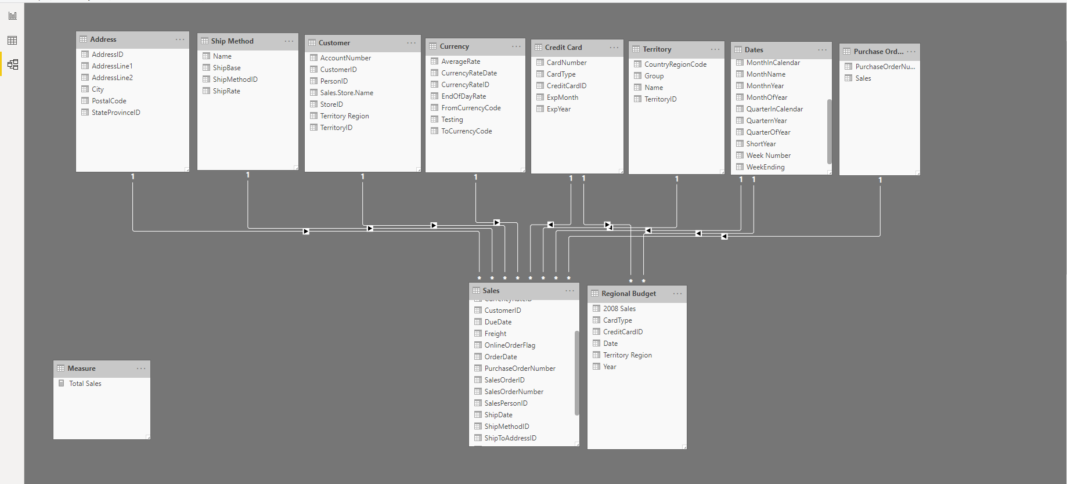
Star Schema - Model
LAYER 2
Shrikesh Pattni
This table i’ve made from the DAX Table Function. I’ve created budget data.
Regional Budget does not exist in Adventureworks 2016 - Warehouse - for
“Sales Order Detail”
LAYER 1

Slide 9
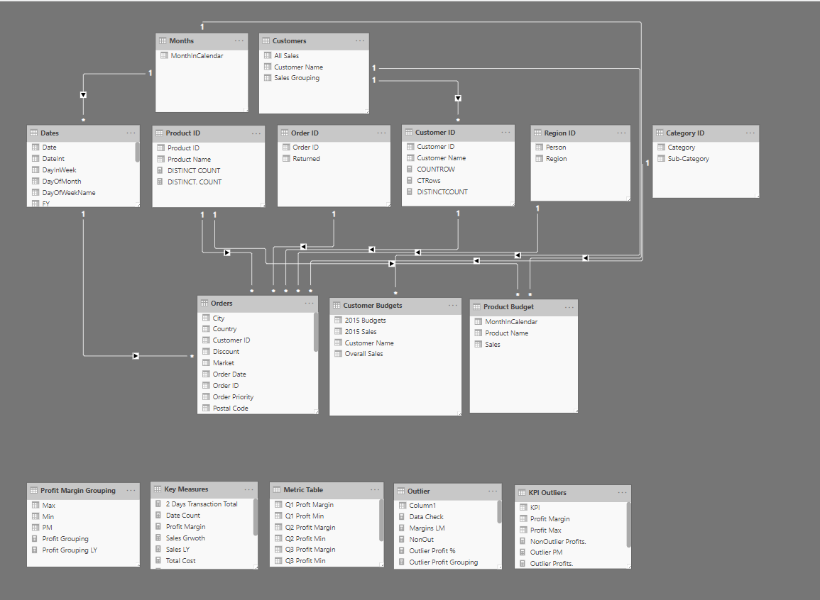
Snowflake Schema - Model
All supporting tables linking dimensions into fact table
LAYER 3
LAYER 2
Main dimension tables above.
(Use for filters, and DAX Calc)
Shrikesh Pattni
Main Fact Tables. All my Sales/Budgeting/Forecasting related tables below
LAYER 1
Tables to put my measures into. Great way for organising your analysis you want to showcase.

Slide 10
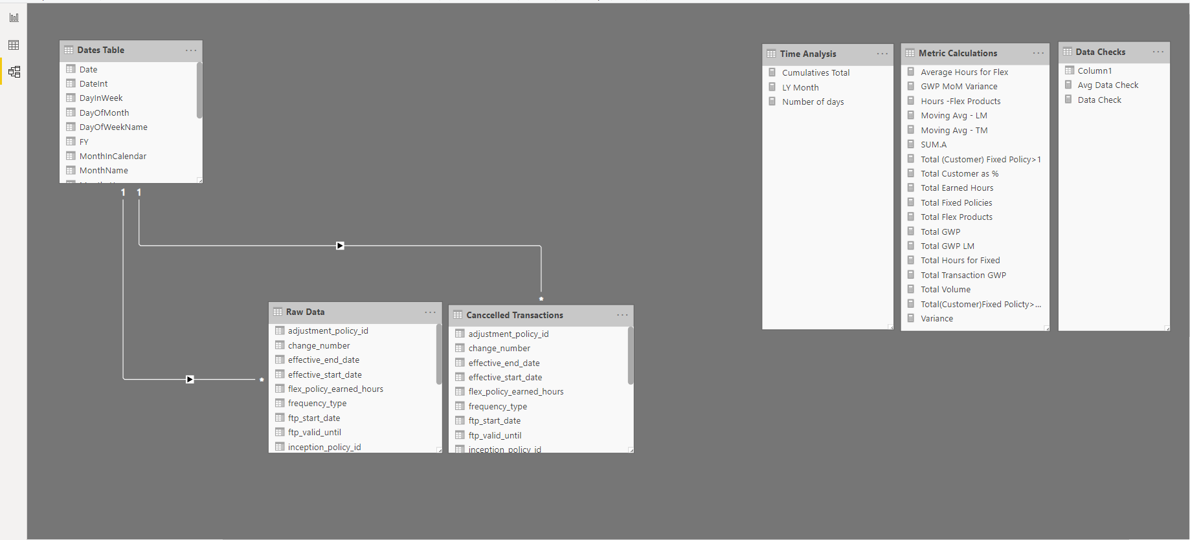
Star Schema - Model
LAYER 2
Shrikesh Pattni
LAYER 1

Slide 11
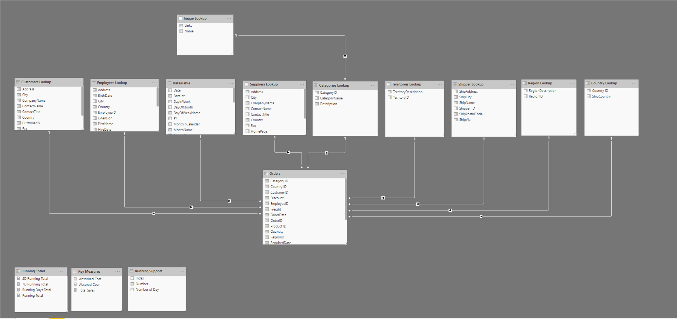
Snowflake Schema - Model
LAYER 3
LAYER 2
Shrikesh Pattni
LAYER 1

Slide 12
Star Schema - Model
LAYER 2
Shrikesh Pattni
LAYER 1

Slide 13
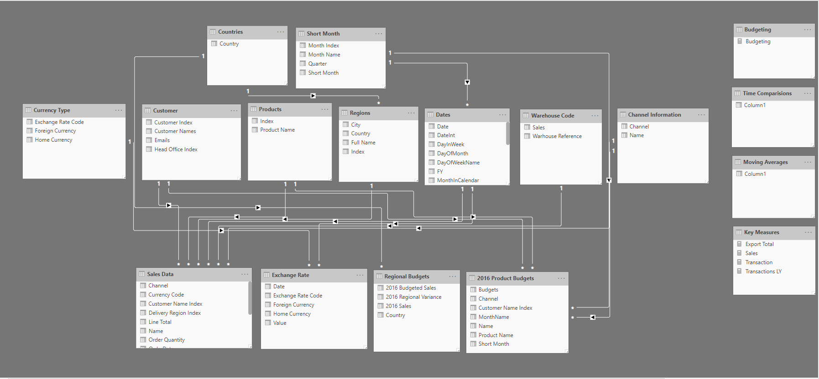
Snowflake Schema - Model
LAYER 3
LAYER 2
Shrikesh Pattni
LAYER 1

Slide 14
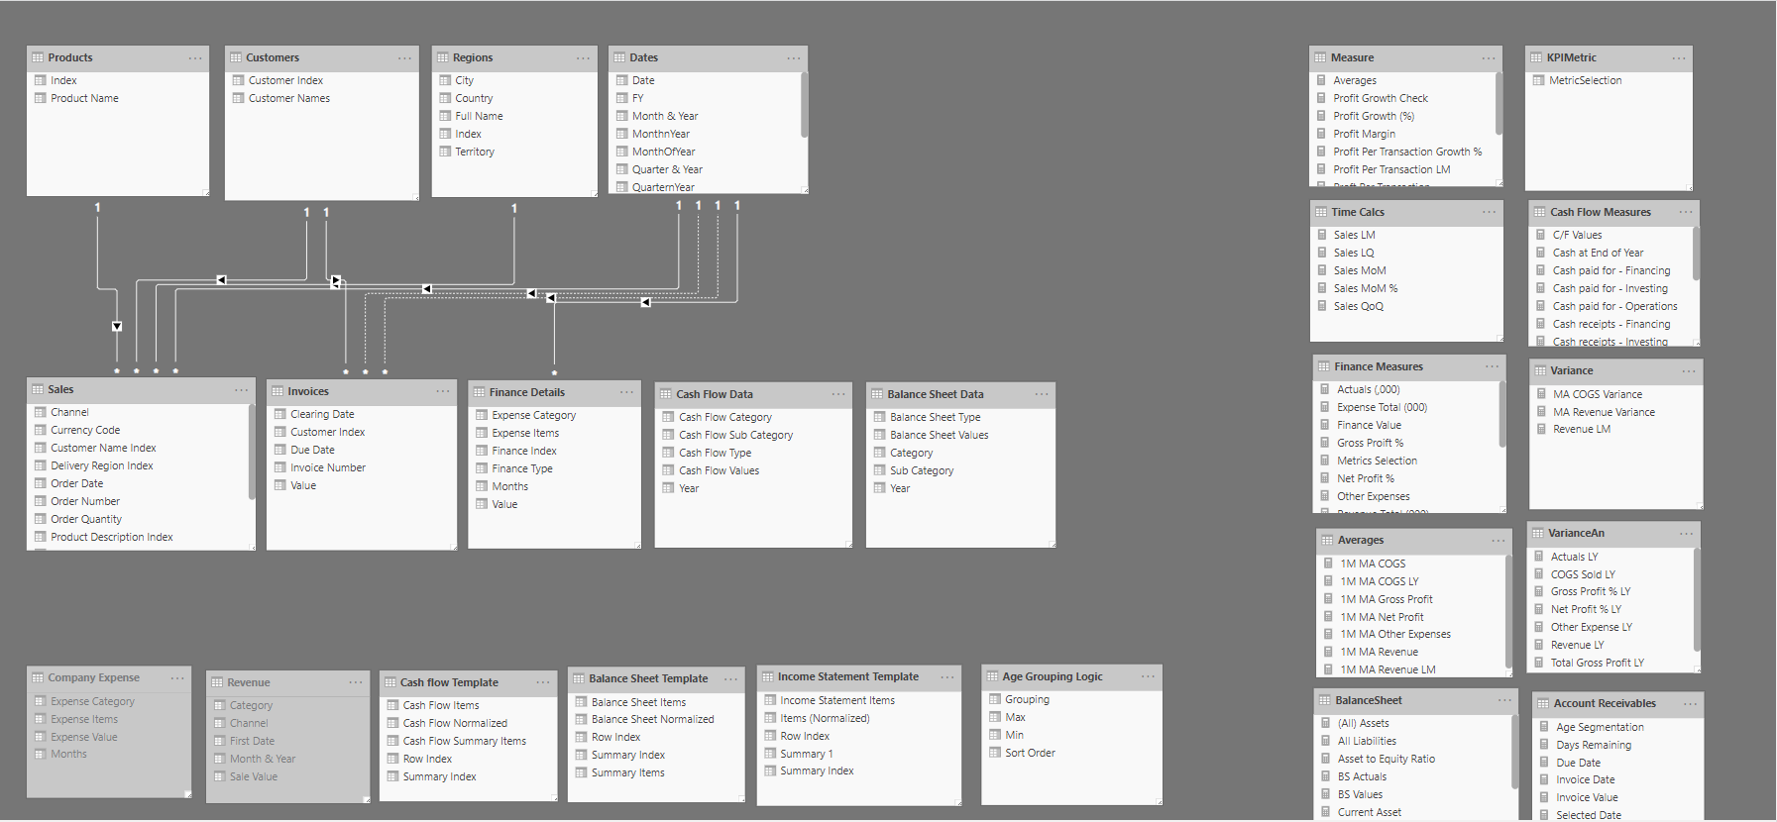
Star Schema - Model
LAYER 2
Shrikesh Pattni
LAYER 1

Slide 15
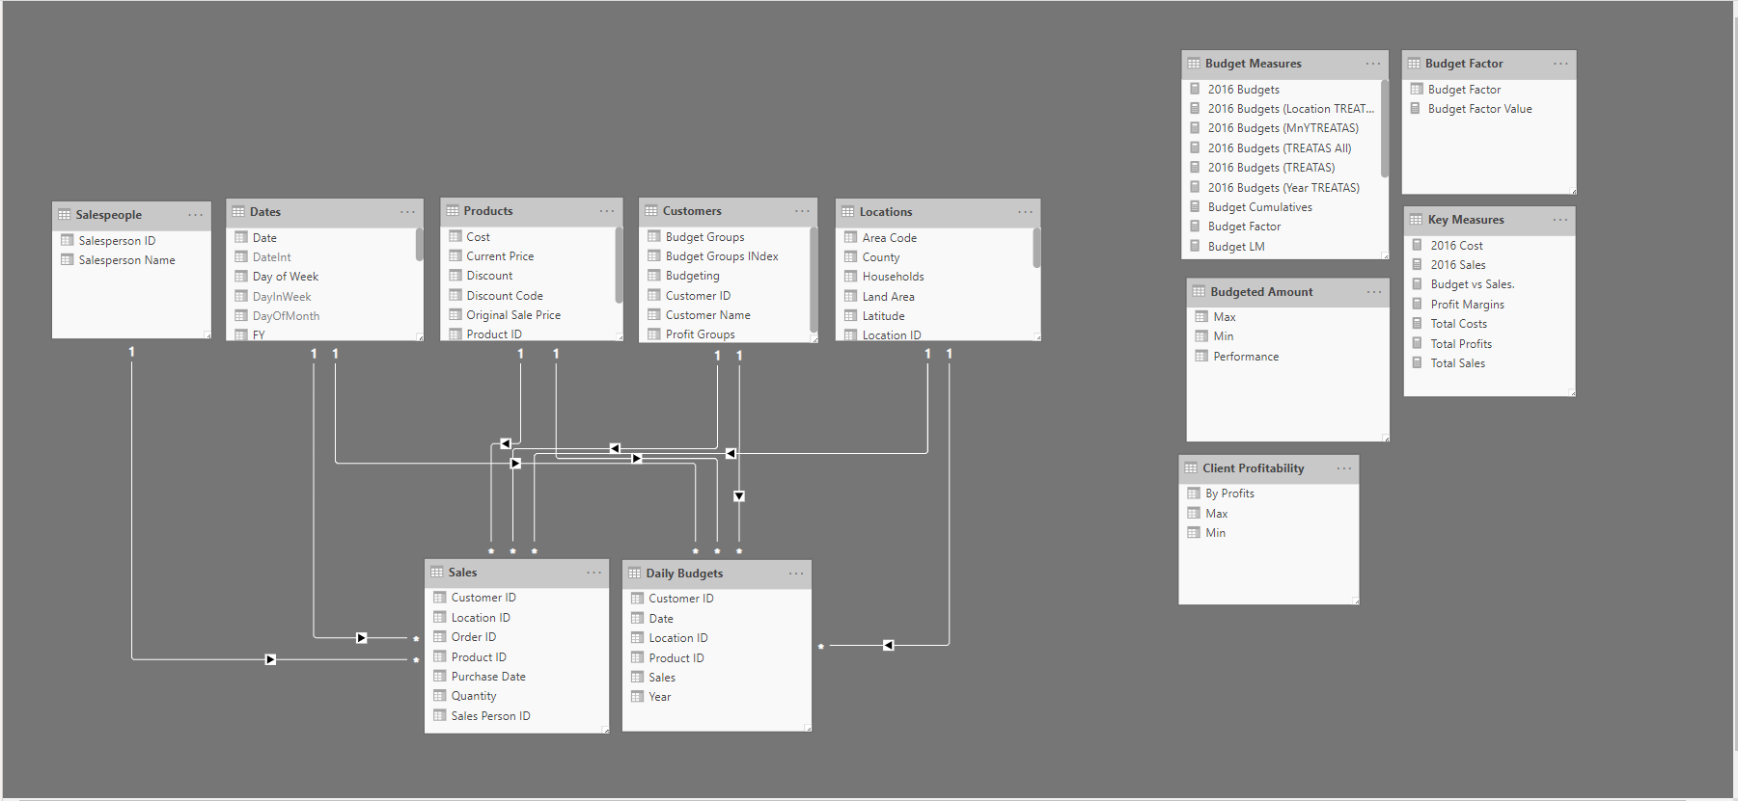
Star Schema - Model
LAYER 2
Shrikesh Pattni
LAYER 1

Slide 16
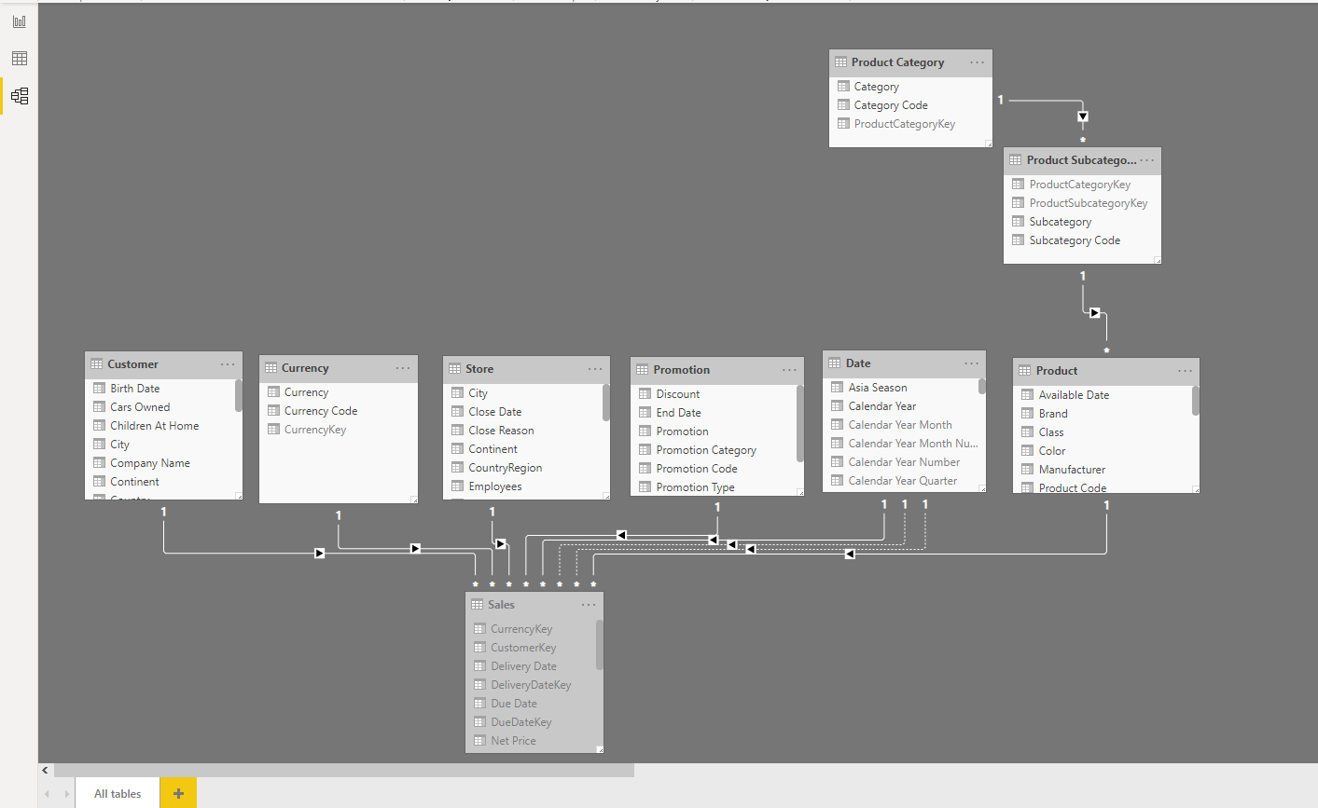
Snowflake Schema - Model
LAYER 4
LAYER 3
Shrikesh Pattni
LAYER 2
LAYER 1

Slide 17
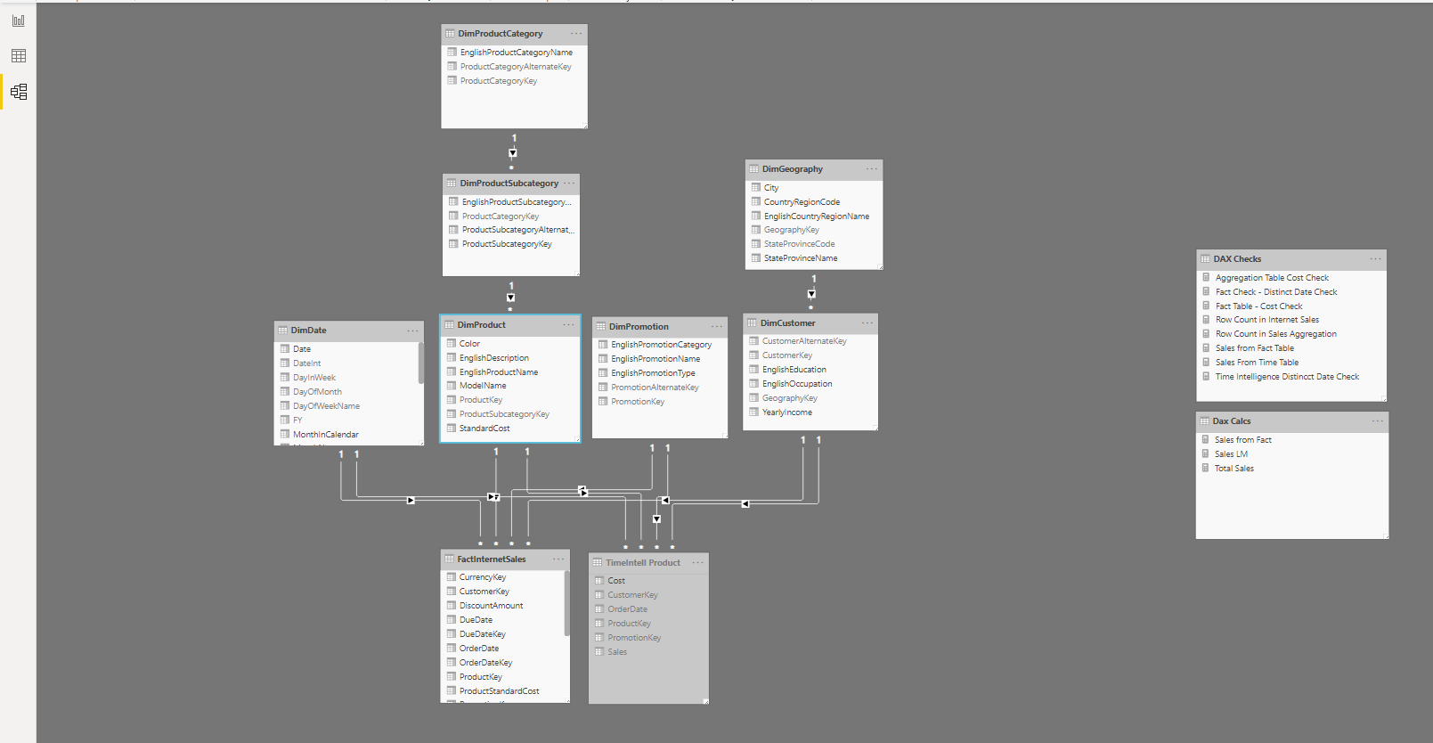
Snowflake Schema - Model
LAYER 4
LAYER 3
Shrikesh Pattni
LAYER 2
LAYER 1

Slide 18
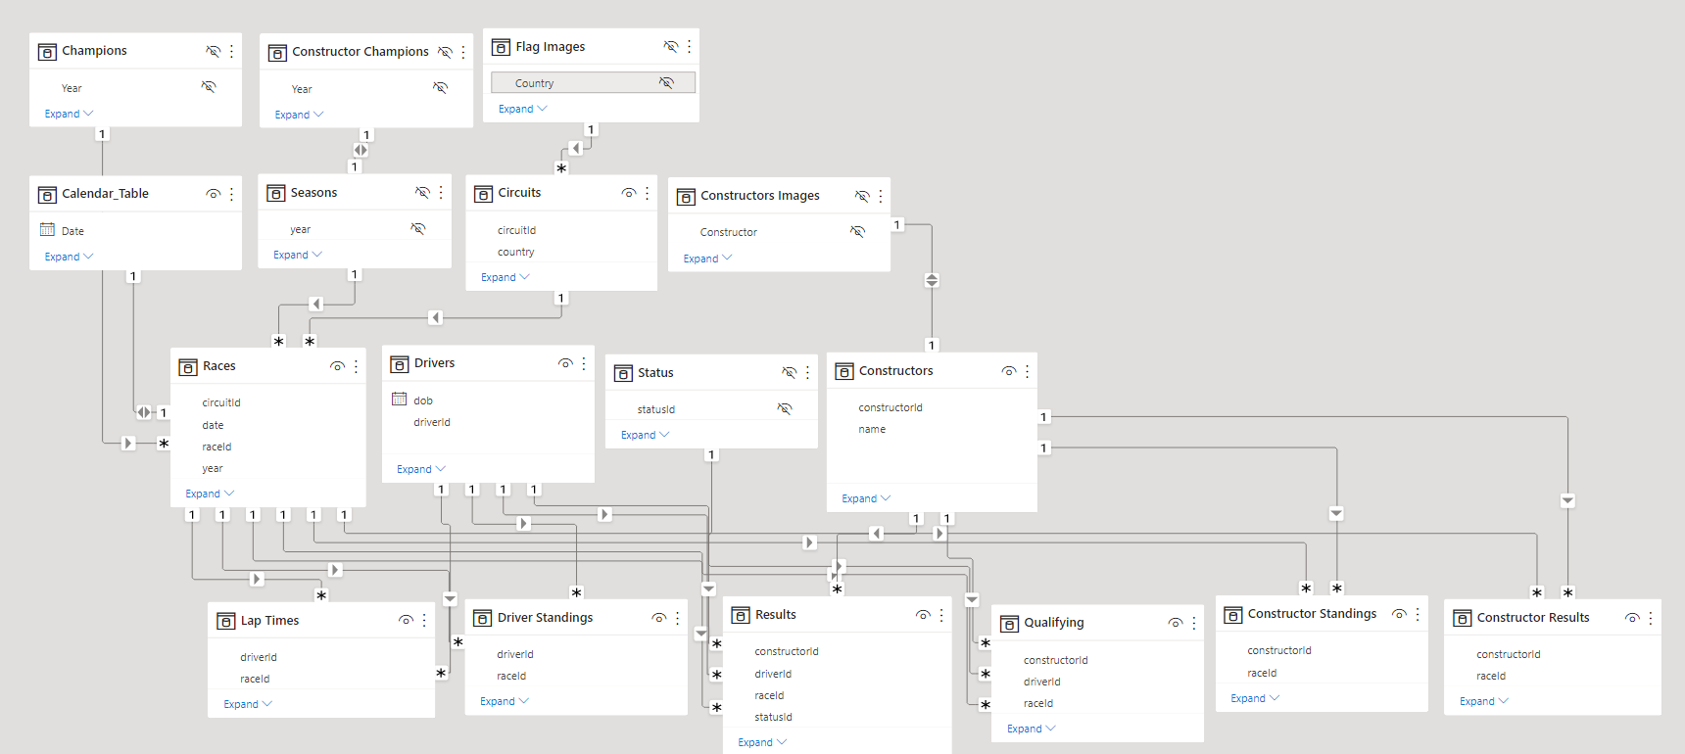
Snowflake Schema - Model
LAYER 4
LAYER 3
LAYER 2
Shrikesh Pattni
LAYER 1

Slide 19
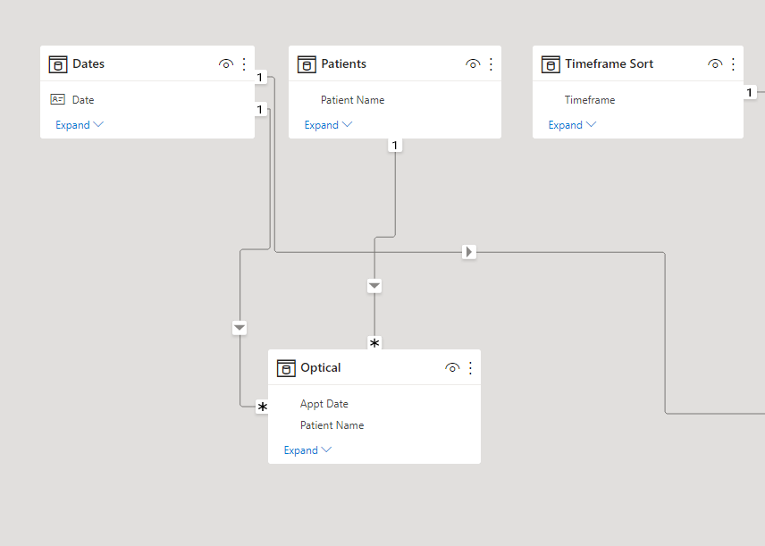
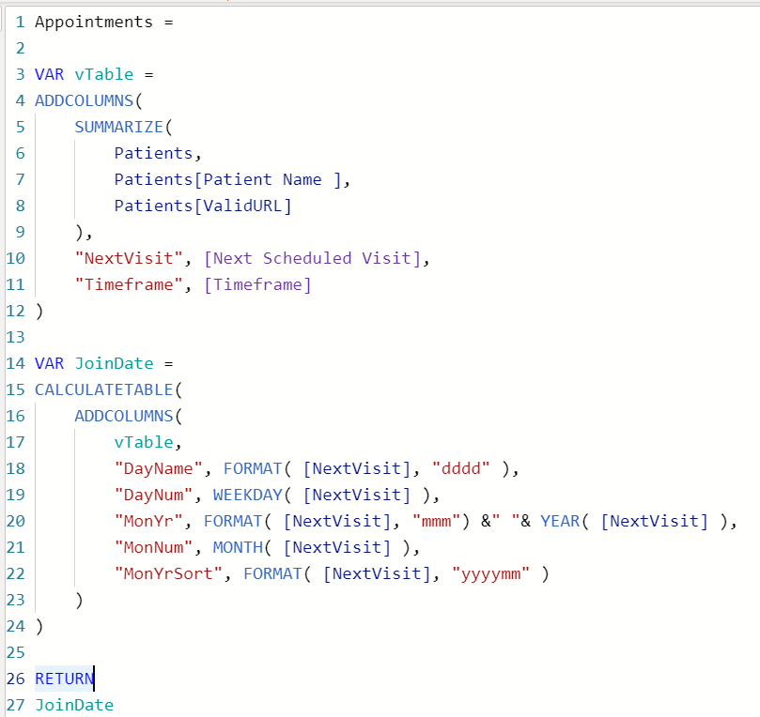
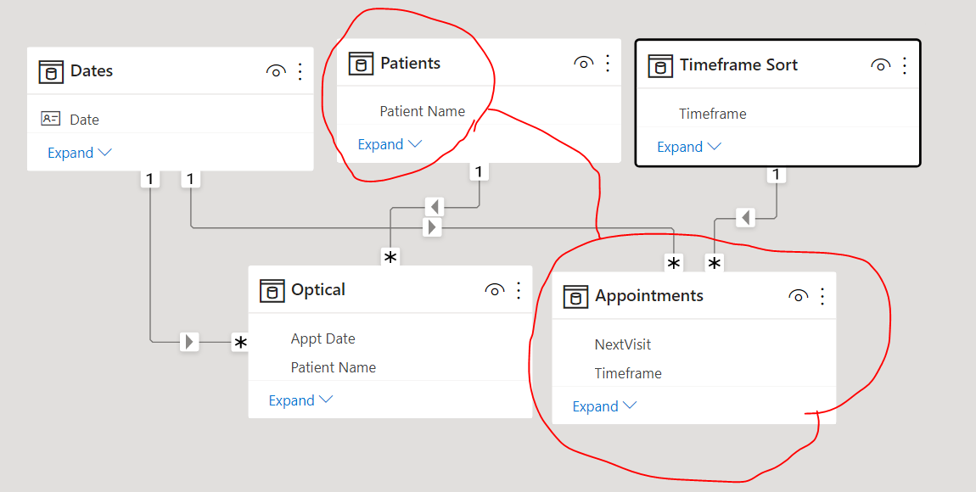
Data Modelling Parent To Child Relationship
Shrikesh Pattni
L2
L1

